Slide 1

Domain: MATLAB
Technology: Communications
COMPARATIVE STUDY OF LINEAR PRECODING TECHNIQUES

Slide 2
Problem Statement:
Implementing any technology such as, 1G, 2G, 3G, 4G and 5G etc., without interference is one of the major issues and a challenge since its emergence. Removing or cancelling out the interference completely is not possible because of various reasons like signal loss, circuit complexity, process complexity etc..

Slide 3
Objectives:
The main objective of our project is to make a comparison between the existing techniques and the proposing technique in minimizing interference. So, we made a comparison between some of the techniques on the basis of Bit-Error Rate and SINR.

Slide 4
Index
Problem Statement
Objectives
Abstract
Introduction
Literature review
Existing Method
Drawbacks
Proposed method
Advantages
Applications
Future Scope
Hardware and Software Requirements
Results
Conclusion
References

Slide 5
Abstract:
Pre-coding the signal at 5G MIMO environments is good and became necessary these days. So, we are implementing Linear Pre-coding for signal transmission. Linear pre-coding techniques like Maximum Ratio Transmission (MRT), Zero Forcing (ZF) and Minimum Mean Square Error (MMSE) are implemented in 5G MIMO environment. The existing techniques like ZF and MMSE are compared with the proposing MRT. Implementation results showed that MRT the new technique shows a very low bit error rate than the remaining two techniques.
Keywords: Maximum Ratio Transmission (MRT), Linear pre-coding Algorithm, 5G mobile communication technology, MIMO, Zero Forcing (ZF), Minimum Mean Square Error (MMSE).

Slide 6
Introduction:
In point-to-point systems, pre-coding means that multiple data streams are emitted from the transmit antennas with independent and appropriate weightings such that the link throughput is maximized at the receiver output. When the receiver has multiple antennas, single-stream beam-forming cannot simultaneously maximize the signal level at all of the receive antennas. In order to maximize the throughput in multiple receive antenna systems, multi-stream transmission is generally required. Precoding is a generalization of beamforming to support multi-stream (or multi-layer) transmission in multi-antenna wireless communications.
If the receiver knows the channel matrix and the transmitter has statistical information, Eigen beamforming is known to achieve the MIMO channel capacity. In this approach, the transmitter emits multiple streams in Eigen directions of the channel covariance matrix. This suboptimal approach cannot achieve the weighted sum rate, but it can still maximize the weighted sum performance (or some other metric of achievable rates under linear precoding).
The optimal linear precoding does not have any closed-form expression, but it takes the form of a weighted MMSE precoding for single-antenna receivers. The precoding weights for a given user are selected to maximize a ratio between the signal gain at this user and the interference generated at other users (with some weights) plus noise. Thus, precoding can be interpreted as finding the optimal balance between achieving strong signal gain and limiting inter-user interference.

Slide 7
Literature Review:
S. No | Journal Type with year | Authors | Title | Outcomes
1 | New York Wiley, 1974 | W. C. Jakes, Jr. | Mobile Microwave Communication | With the use of moderately large antenna arrays the efficiencies of energy and spectrum has improved with many orders than a one-antenna system
2 | Signal Processing Magazine, IEEE, 2013, 30(1): 40-60 | Rusek F, Persson D, Lau B K, et al. | Scaling up MIMO: Opportunities and challenges with very large arrays | For maintaining a fixed per user rate loss as compared to RZF, the degree of polynomial need not to vary, but it should be increased with the quality of the channel knowledge and SNR.
3 | Signals, Systems and Computers, 2013 Asilomar Conference on.IEEE, 2013: 285-290 | Zarei S, Gerstacker W, Schober R. | A low-complexity linear precoding and power allocation scheme for downlink massive MIMO systems | Comparison of the Maximum ratio combining and Almouti’s schemes for transmitting and receiving more than one copy of original signals.

Slide 8
Literature Review:
S. No | Journal Type with year | Authors | Title | Outcomes
4 | Personal Indoor and Mobile Radio Communications (PIMRC), 2013 IEEE 24th International Symposium on. IEEE, 2013ement. 2020;16(3):391–460. | Zarei S, Gerstacker W, Muller R RPC. | Low-complexity linear precoding for downlink large-scale MIMO systems | Comparison of linear pre-coding techniques such as, MRT and ZF.

Slide 9
Existing Method:
Zero Forcing:
Zero Forcing (ZF) aims to produce a matrix which is the pseudo-inversion of the channel matrix of user that reduces the interference between the users. ZF searches to make zeros of whoever the user is causing the interference. Even then, the ZF will results in loss of some portion of the signal every time.
Minimum Mean Square Error:
Minimum Mean Square Error (MMSE) is the extended method of Zero Forcing (ZF). The main aim is to make the system capable of handling the interference without forcing them to zero. Both are very same process only the calculation of Beta which is the new parameter introduced in the MMSE. At a low SINR environments beta becomes zero making only ZF remained. At a high SINR environments beta will comes into play resulting in the minimizing of interference.
Maximum Ratio Emission Precoding Algorithm
The matched filter precoding algorithm is the MRT precoding technology used in downlink. The ideal channel transmission environment is one in which the channels from the base station to the various user terminals are as independent as feasible. The efficiency of MRT precoding in large-scale MIMO systems greatly depends on this environment. Formula 3 is the expression of MRT precoding for the kth user in the cell. MRT precoding is a very basic precoding technique that increases each user's SNR while ignoring interference from other users.

Slide 10
Disadvantages in Existing Method:
The Zero Forcing will results in signal loss every time.
The MMSE will be not producing the better results at massive MIMO environments.

Slide 11
Proposed Method:
This paper considers, The Linear Pre-coding technique of Block Diagonalization (BD) will be implementing on 5G MIMO environment. Along with the other linear pre-coding techniques such as, Maximum Ratio Transmission (MRT), Zero Forcing (ZF) and Minimum Mean Square Error (MMSE) will also be implemented and made comparison between later techniques with proposing BD technique and the parameters are verified through simulation. We have made comparison among many linear precoding techniques in 5G MIMO even though Maximum Ratio Transmission (MRT) performed better, Block Diagonalization (BD) is easier to implement.
Each user's linear precoder and receiver filter can be obtained by twice SVD operations. Diagonalization, the key idea of the BD algorithm is to employ the precoding matrix to suppress the MUI completely. To eliminate all MUI, the following constraint is imposed. where kis the diagonal matrix of which the diagonal elements are non-negative singular values of ~Hk and its dimension equals to the rank of ~Hk. Vk(0)contains vectors corresponding to the zero singular values, and Vk(1)consists of the singular vectors corresponding to nonzero singular values. Thus, Vk(0)is an orthogonal basis for the null space of ~Hk. In order to maximize the achievable sum rate of the BD, the water filling algorithm can be additionally incorporated.

Slide 12
Advantages of Proposed Method:
Maximum Ratio Transmission (MRT)’s main advantage is its low bit-error rate compared to previous techniques.
MRT is very consistent at even low SINR environments.

Slide 13
Applications of Proposed Method:
Applications of Classification are: 5G MIMO, Satellite Communication and in Beamforming etc.

Slide 14
Future Scope:
The future scope of a comparative study of linear precoding techniques depends on the specific research question or problem being investigated. However, here are some potential areas of future research that could build upon a comparative study of linear precoding techniques:
Liner Precoding technique: The technique called Block Diagonalization preforms better than the remaining Precoding techniques.
Non-linear precoding techniques: A comparative study of linear precoding techniques could be expanded to include non-linear precoding techniques. This could involve investigating the performance of different non-linear precoding techniques, such as Tomlinson-Harashima precoding or dirty paper coding, and comparing them to the linear precoding techniques studied.
Multiple input multiple output (MIMO) systems: Linear precoding techniques are often used in MIMO systems to improve the performance of wireless communication. A future study could focus on the performance of different linear precoding techniques in MIMO systems with various antenna configurations..

Slide 15
Hardware & Software Requirements:
Software: Matlab R2020a or above
Hardware:
Operating Systems:
• Windows 10
• Windows 7 Service Pack 1
• Windows Server 2019
• Windows Server 2016
Processors:
Minimum: Any Intel or AMD x86-64 processor
Recommended: Any Intel or AMD x86-64 processor with four logical cores and AVX2 instruction set support
Disk:
Minimum: 2.9 GB of HDD space for MATLAB only, 5-8 GB for a typical installation
Recommended: An SSD is recommended A full installation of all MathWorks products may take up to 29 GB of disk space
RAM:
Minimum: 4 GB
Recommended: 8 GB

Slide 16
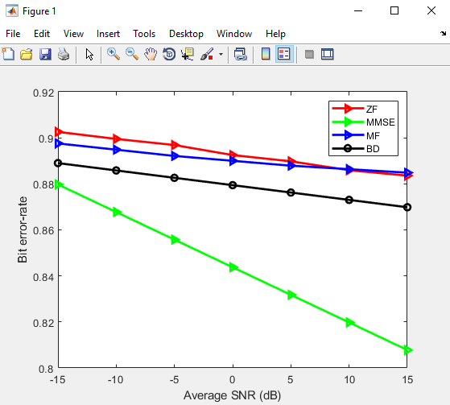
Results

Slide 17
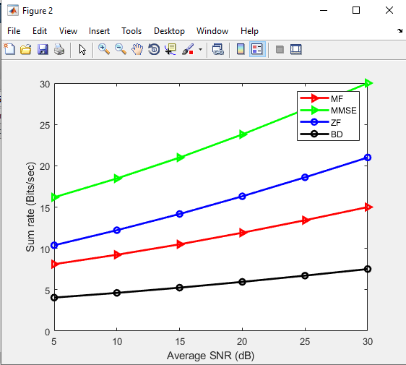

Slide 18
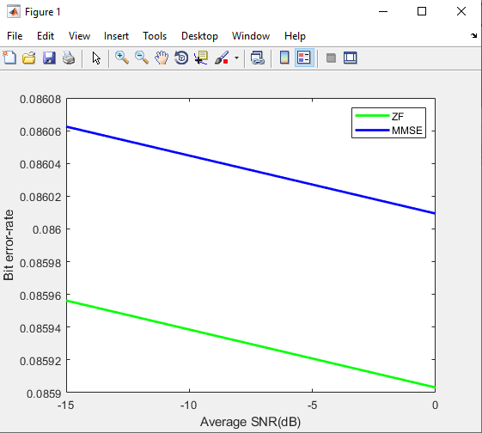

Slide 19
Conclusion:
Here, in this research, we put four linear pre-coding approaches into practise and compared them. In comparison to the other four employed approaches, MRT has the lowest bit error rate and highest sum rate, according to the implementation. Finally, we can say that MRT is the best of the four, but ZF and MMSE perform better in high SNR environments, and BD is more reliable and straightforward to use. Finally, we can say that, compared to all the other linear precoding techniques, the Block Diagonalization (BD) precoding technique is the most straightforward to use.

Slide 20
References:
[1] W. C. Jakes, Jr., Mobile Microwave Communication. New York Wiley, 1974.
[2] Rusek F, Persson D, Lau B K, et al. Scaling up MIMO: Opportunities and challenges with very large arrays [J]. Signal Processing Magazine, IEEE, 2013, 30(1): 40-60.
[3] Zarei S, Gerstacker W, Schober R. A low-complexity linear precoding and power allocation scheme for downlink massive MIMO systems[C]//Signals, Systems and Computers, 2013 Asilomar Conference on IEEE, 2013: 285-290.
[4] Zarei S, Gerstacker W, Muller R R, et al. Low-complexity linear precoding for downlink large-scale MIMO systems[C]//Personal Indoor and Mobile Radio Communications (PIMRC), 2013 IEEE 24th International Symposium on. IEEE, 2013: 1119-1124.

